Slide 1


MEKONG SCHOOL
OF
ENGLISH (MSE)
Presented by:
Norng sokha
Director of Mse
Tel: 098 45 99 45
Email: nsokha@mekong.edu.kh
Academic year 2011 - 2012

Slide 2
Cambodian Mekong University (CMU)
Faculty of Mgt & Tourism
Faculty of Science & Technology
Faculty of Arts, Humanities & Foreign Languages
Faculty of Law
Faculty of Social Science
Faculty of Economics

Slide 3
Faculty of Arts, Humanities & Foreign Languages
Mekong School of English
Mekong school of Japanese
Mekong School of Education

Slide 4
About Mekong School of English (MSE)
Vision
To develop learners to be Creative and Innovative in Education and Business with Proficient use of English.
Mission
To promote effective learning & teaching
To promote professional communication nationally & internationally
To promote other skills related to education, business & entrepreneurship

Slide 5
Programs
Bachelor Degree
Bachelor of Education in Teaching English as a Foreign Language (BEdu. in TEFL)
Bachelor of Arts in Business English (BA. in BE)
Associate Degree
Associate in English Literature (ASS in EL)
5

Slide 6
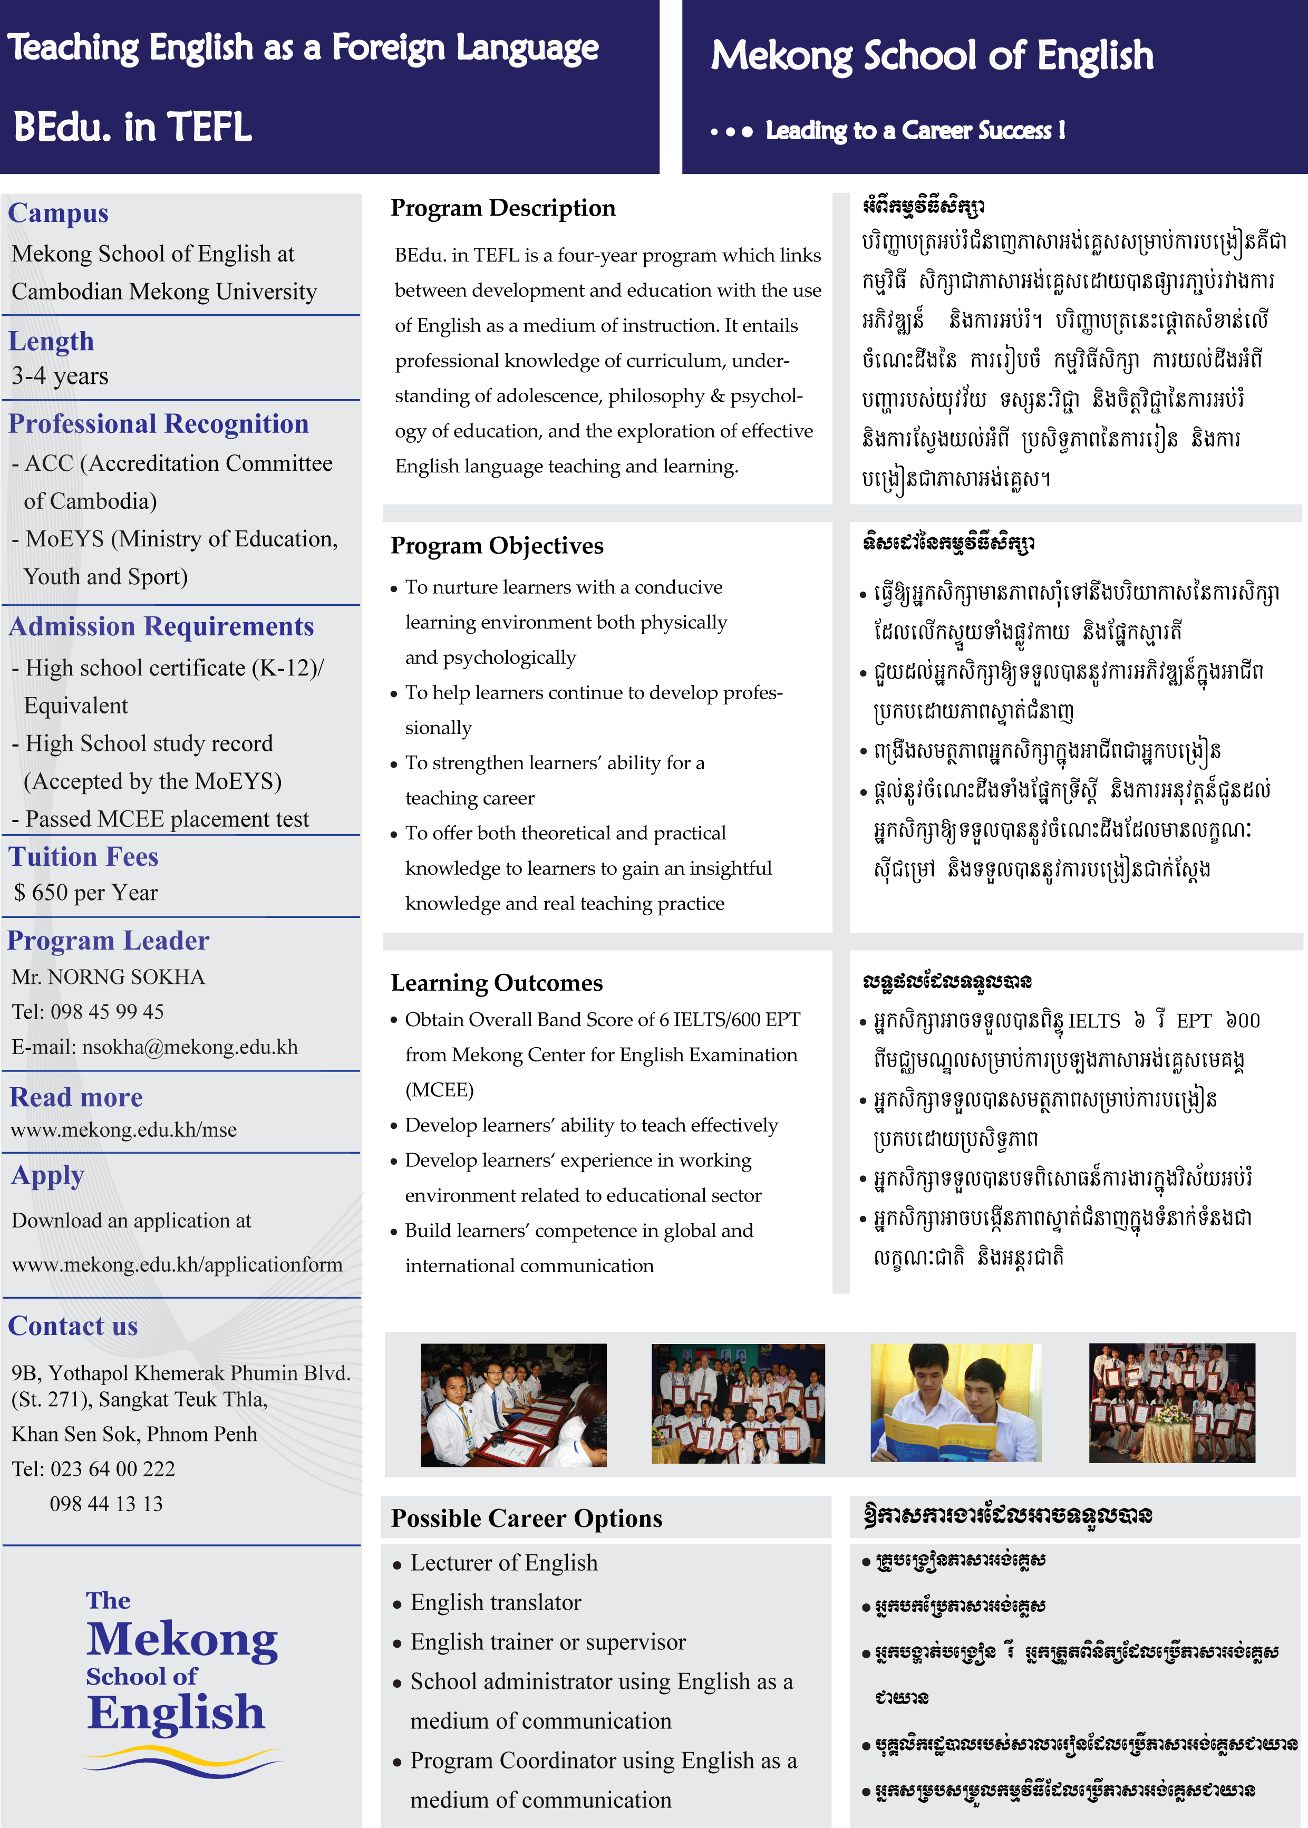
Learning Outcomes & Career Options for TEFL

Slide 7
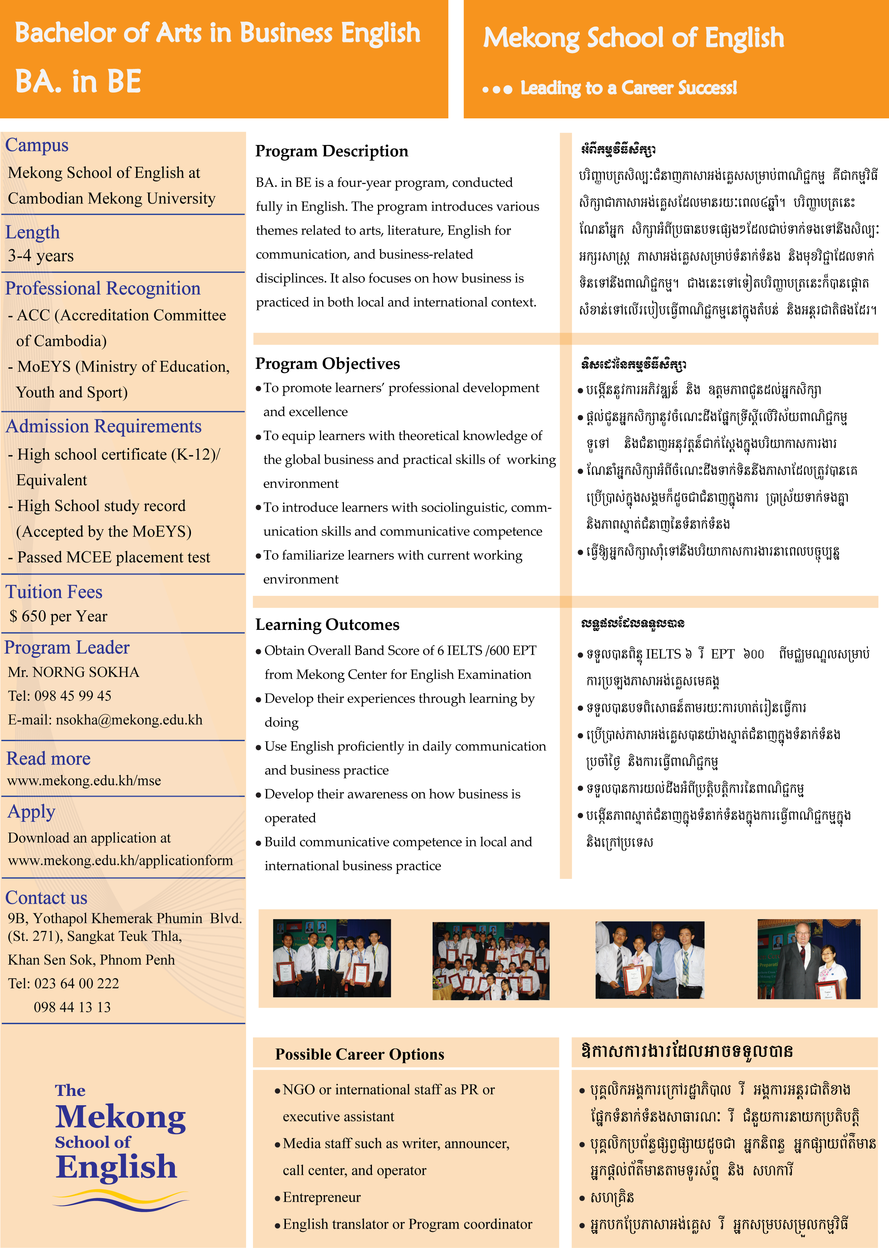
Learning Outcomes & Career Options for Business English

Slide 8
Curriculum Structure
Requirement | TEFL | BE | AD
Foundation Courses (FC) | 30 | 30
General Compulsory Courses (GCC) |  |  | M/P
Arts & Humanities Courses (AHC) | 21 | 18 | 18
Major Required Courses (MRC) | 40 | 40 | 26
Major Concentration Courses (MCC) | 24 | 24 | 18
Elective Courses (EC) | 6 | 9 | 3
Thesis & Projects | 27 | 27 | 12
Total Credits Exclude Thesis & Projects | 121 | 121 | 65
8

Slide 9
Detailed Curriculum
Foundation Courses
Arts & Humanities
Social Science
Science
Foreign Language
Skills
General Compulsory
Computer Application
9

Slide 10
Arts & Humanities Courses
Literature
History & Culture
Sociology
Adolescence
Human Communication
Major Required Courses
Listening, speaking,
reading & writing
Grammar & vocabulary
Sentence Skills
10

Slide 11
Major Concentration Courses (TEFL)
Applied Linguistics
Teaching Methodology
Foundations of Education
Educational Psychology
Educational Management
Classroom Management & Curriculum Development
Testing in EFL
Peer Teaching & Practicum
11

Slide 12
Major Concentration Courses (BE)
Principles of Marketing
Principles of Management
Economic Thinking
Understanding Business
Communication Applications
Fundamentals of Leadership
Entrepreneurship
12

Slide 13
Graduate Requirements
Obtained at least 121 credit
Obtained lat least 62 credits (Associate)
Passed State Exam
Entrepreneurship Project
Projects Required by the school
13

Slide 14
Personal Development
What is Personal Development?
II. Importance of Personal Development

Slide 15
I. What is Personal Development?
Aristotle defined “Personal Development … practical wisdom”
Confucius defined “Personal Development … the source of managing the family and the state”

Slide 16
II. Importance of Personal Development
self-knowledge &
identity
develop talents
&
potential
build human capital
&
employability
enhance quality of life

Slide 17
Decision
Action
Result
Thought/ Mindset
Feeling

Slide 18
Decision on
‘Value’
Action
on ‘the value’
-Degree
-Career
-Quality of life
Thought/ Mindset
Feeling about ‘Value’

Slide 19


III. Goal Settings & Planning
What you want to be…?
Where you want to go…?
Goals
Action
Success

Slide 20
Materials or Wealth …?
Income …?
Knowledge & Skills …?
Oversea trips …?
…?

Slide 21
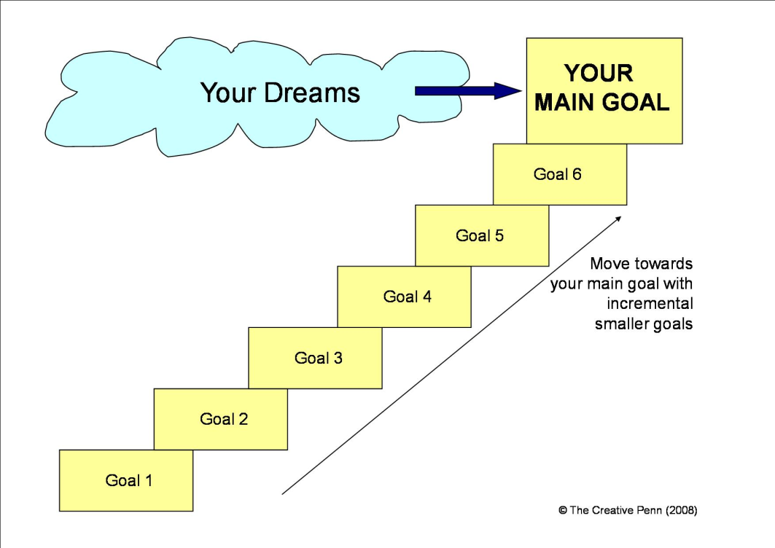
Why Set Goals?
Long-term vision
Short-term motivation
Time
Resource
Improve quality of life

Slide 22

S - Specific (or Significant)
M - Measurable (or
Meaningful)
A - Attainable
(or Action-Oriented)
R - Relevant
(or Rewarding)
T - Time-bound
(or Trackable)

Slide 23
From Big to Small
10 years
5 years
1 year
1 month
1 week
1 day

Slide 24
Thanks for Your Participation!

